Slide 1

THERMAL FLOATER
The Floating Solar Thermal energy generation module

Slide 2


Slide 3
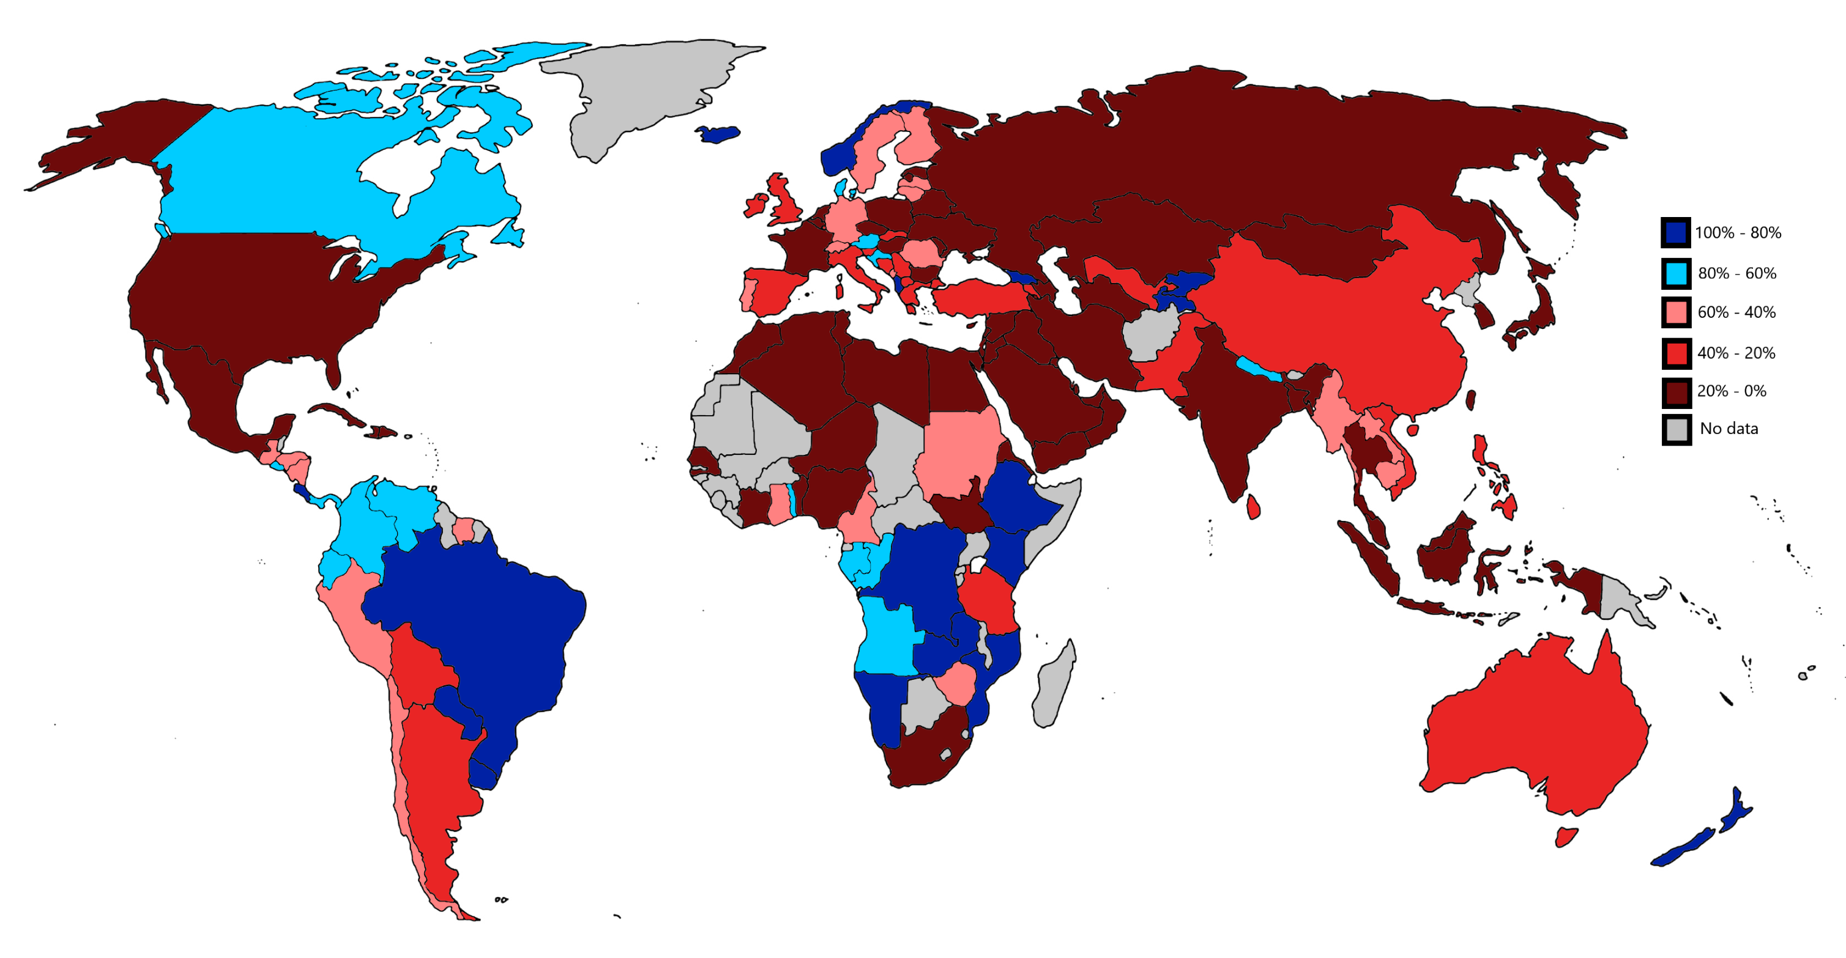
BACKGROUND PROBLEM
World is still heavily reliant on fossil fuels
Limited access to renewable energy in developing and busy countries
Limited availability of land for renewable power generation
Vast amounts of unused water bodies despite their potential for productive purposes
PERCENTAGE OF RENEWABLE ENERGY FROM EACH COUNTRY IN THE WORLD
Notes:
Today, the world still heavily relies on fossil fuels and even continues subsidizing them. Despite the increasing demand for renewable energy sources in all countries across the globe, people from developing countries despite contributing to the majority of the world population, do not have access to it.
We were driven to solve the problem of frequent blackouts and unreliable electricity supply in our hometown, which only worsened during lockdowns. We realized that although there are various methods of renewable energy generation, none of them provided a consistent and regular supply of electricity. This led us to research the challenges associated with renewable energy, and we discovered that it is often very expensive to set up, and requires a significant amount of land, which is scarce in densely populated areas and countries like India. Frustrated and unable to find a suitable, affordable, and compact alternative, we took it upon ourselves to develop a solution.

Slide 4

THERMAL FLOATER
The Thermal Floater is a device that floats on water and efficiently converts the Thermal Heat from the Sun into electrical energy while keeping a small form factor. It has a modular design and can easily be connected with similar modules to create an array for supplying power for various uses.
Notes:
The thermal floater aims to address these challenges by providing a cost-effective and environmentally friendly solution. It utilizes the Sun’s thermal heat and floats on unused water bodies to create a temperature difference, thereby generating electricity very economically, making renewable energy accessible to even the common man. It has a modular design and can easily be connected with similar modules to create such an array for supplying power for innumerable uses.

Slide 5
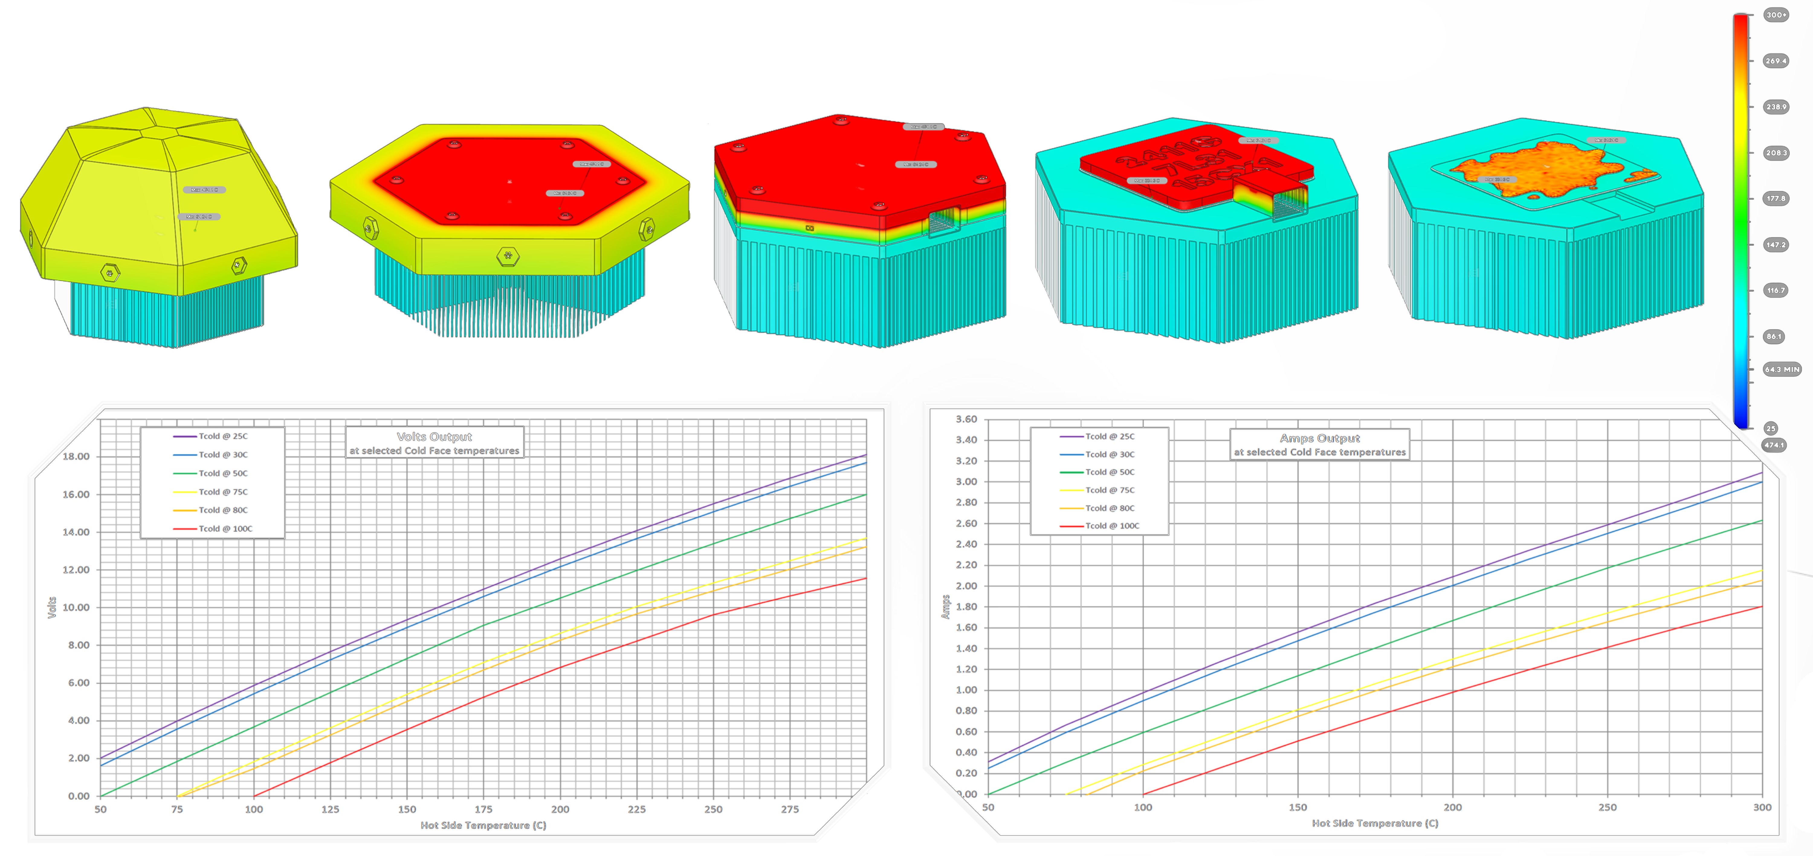
RESEARCH AND SIMULATIONS
Notes:
We performed lots of research and simulations to evaluate the feasibility of our idea and went through a rigorous process of working with users and incorporating their feedback into our idea. The prototypes that we iteratively built, exceeded our expectations. One single cell can generate upto 540 WH in a day and our research suggests that this has the potential to be even more efficient than what we currently propose. Our ongoing technological developments suggest that the efficiency can be improved further, potentially reaching up to 1430 W in a day, which would be nine times more efficient than solar panels. This increased efficiency translates into higher energy output and cost savings for customers. But the impact that it can do right now, has the potential to revolutionize the renewable energy industry.

Slide 6

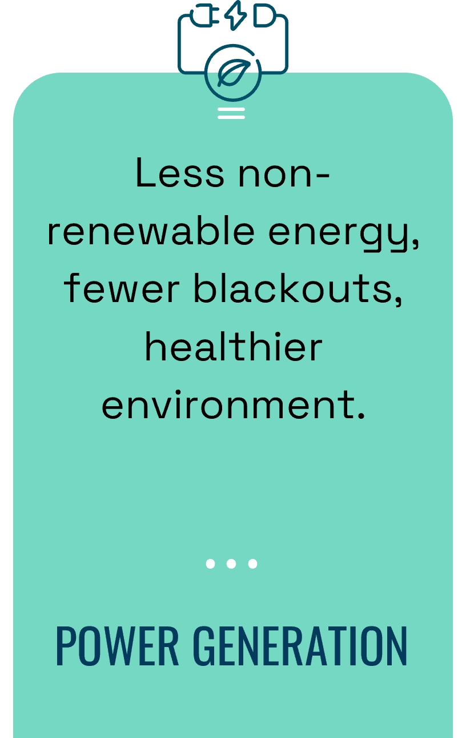
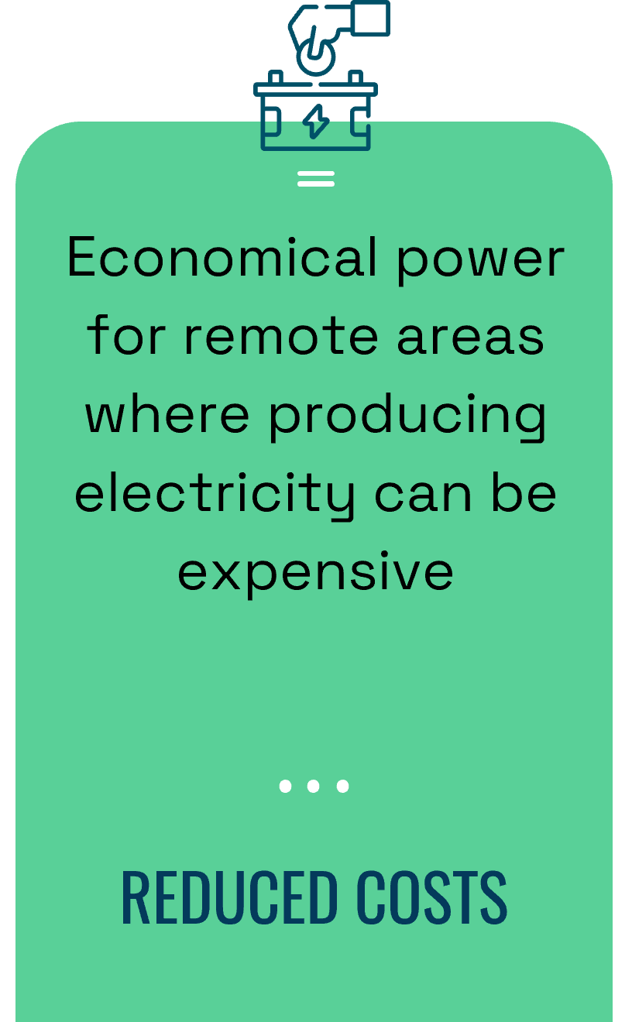
SOCIAL IMPACT
Notes:
Our main objective is to make it accessible to the common man and bring them to the renewable energy trend by removing the barriers that stopped them. Not only that, it will also help in contributing to decrease the non-renewable energy usage, mitigate power blackouts and positively impact the environment and the human health. Due to its modular design, it is cost effective and quite useful for generating electricity in remote areas/ military bases/ research bases in islands where generating electricity is highly expensive and can be detrimental for the environment.

Slide 7
MARKET SIZE
$ 1030 bn
$ 294 bn
$ 51 bn
TAM
SAM
SOM
TAM for renewable energy at global scale.
Market size for renewable energy pertaining to water / oceans
Obtainable market size for floating renewable energy devices

Slide 8
BUSINESS CANVAS
PARTNERS
ACTIVITIES
VALUES
RELATIONSHIPS
CUSTOMERS
Project based partners
Government, Institutions & Power Utilities
Investors
Building a global network and creating momentum
Projects and Services
Cost Friendly, Reliable and Renewable Energy
Thermal Floater and associated technology
Contract term with service & repair including savings by Realtime monitoring
Power Utilities, governments, institutions and individuals
Electricity generation in remote areas / research bases and military bases
RESOURCES
CHANNELS
Key raw materials, Machines for manufacturing and assembly, and a skilled team
Established power supply network, Consultations and advice, social media & website
Gathering Key Resources
Technology Development
Project Management
Project Development rights and funds
Consultancy & Project management fees
Thermal Floater and associated tech
COSTS
REVENUES
Notes:
We aim to partners with the power facility grids and utilities, institutions, governments to help achieve the key activities and deliver value to the customers. Our vision is to spread green and renewable energy throughout the world by the end of the decade by building making it accessible to everyone.
As a business, we will be providing our main product, the thermal floater, as well as consultation and maintenance on these devices. We aim to target the market of people and companies who want to move towards efficient renewable sources of energy, the power grids, governments, companies, and private developers. The revenue models would be mainly B to B but B to C as well and arrays of these modules would be set up in various locations in association with the key partners.

Slide 9
MARKET COMPETITITON
3X MORE
20CM x 20CM
33% LOWER $
Produces 20kWH per day which is 3x more energy than a solar panel of same size at $0.64 per watt
It is compact, modular & floats on water thereby taking no land space & utilizing water bodies
Priced much lower than its competitors which are solar panels, due to its modularity and efficiency
Notes:
The Thermal Floater represents a significant innovation in the renewable energy sector. It is small and modular making it highly adaptable to be installed in various bodies of water and takes up no land space. It is also highly efficient and can produce 20 kwh/day which is 3 times more electricity than a solar panel of the same size. It is also priced lower than its competitors at 0.64$ per watt making it a good purchase for a common man allowing for a large user base putting it at a significant advantage compared to rest of the renewable technologies in the market. By providing an efficient solution that is both cost effective, environmentally friendly, and modular, it allows for easy deployment and scalability, providing flexible power solutions for a range of applications.
By using the Thermal Floater, companies can directly produce green energy, eliminating the need to purchase carbon credits. This not only aids in achieving carbon-neutral goals but also simplifies green energy strategies making sustainability a mainstream goal

Slide 10
UNIQUE VALUE
The average cost for a solar panel is $1 to $1.50 per watt. Currently, one thermal floater can produce 540 W in a day at $0.64 per watt which is 3x more efficient than a solar panel but with ongoing technological development, it has the potential to produce 1430 W in a day which is 9x the efficiency of a solar panel.
Notes:
The thermal floater has the potential to provide energy at a competitive price in the market. The initial cost of the thermal floater is already lower compared to traditional solar panels, with a cost of $0.64 per watt as opposed to the average cost of $1 to $1.50 per watt for monocrystalline solar panels. This cost advantage can make the thermal floater an attractive option for power corporations and other customers looking to set up renewable energy grids.
Furthermore, the thermal floater's efficiency is three times higher than that of solar panels, allowing it to generate 540 W in a day. However, ongoing technological developments suggest that the efficiency can be improved further, potentially reaching up to 1430 W in a day, which would be nine times more efficient than solar panels. This increased efficiency translates into higher energy output and cost savings for customers.
In the context of power corporations setting up large-scale renewable energy systems, such as 1 MW systems, the thermal floater's cost advantage becomes even more significant. With just two thirds of the cost of solar panels at three times the efficiency, the thermal floater can provide substantial savings in terms of upfront investment and operational costs.

Slide 11
CURRENT & FUTURE PLANS
PROGRESS
GOAL 2
GOAL 1
GOAL 3
Research Paper, Simulations, Proof of Concept and Prototype
Get manufacturer samples and modify designs for ease of manufacuting
Enhance prototype efficiency & modular mechanism
File for patent and small scale testing in association with a power utility company

Slide 12


OUR TEAM & ACHIEVEMENTS
SPARSH
SHIVANSH ANAND
CHILDREN’S CLIMATE PRIZE
YOUTH IDEATHON
ENTREPRENEURSHIP CAMPUS
SAMSUNG SOLVE FOR TOMORROW
Passionate student, innovator and developer interested in 3D modelling, prototyping, web development and automation
Driven by desire to make positive impact in environment and interested in theoretical physics, mathematics and research
JAMES DYSON AWARD

Slide 13
THANKS!
Do you have any questions?
]]
incybot@gmail.com +91 8651769522 thermalfloater.github.io

